Slide 1
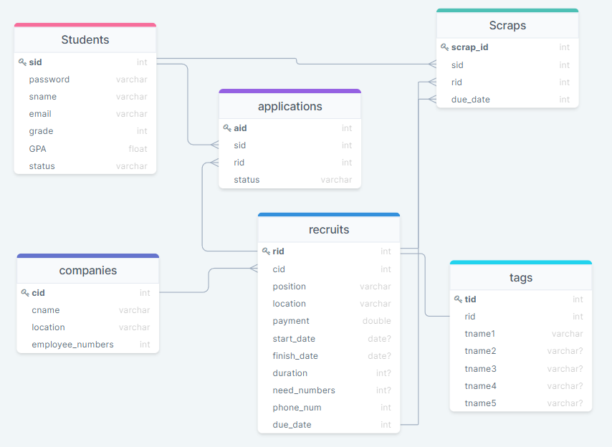

Slide 2
학생 테이블
sid(학번), password(?), sname(이름), email, grade, GPA, status(등록 상태)
CREATE TABLE Students (
sid int NOT NULL PRIMARY KEY,
password varchar NOT NULL,
sname varchar NOT NULL,
email varchar NOT NULL,
grade int NOT NULL,
GPA float NOT NULL,
status varchar NOT NULL,
);
기업 테이블
cid(기업번호), cname(기업명), location(위치), employee_numbers(직원수)
CREATE TABLE Companies (
cid int NOT NULL PRIMARY KEY,
cname varchar NOT NULL,
location varchar NOT NULL,
Employee_numbers NOT NULL,
);
모집 테이블
Rid(모집번호), cid(기업번호), position, location, payment, start_date, finish_date, duration, need_numbers, phone_num, due_date
CREATE TABLE Recruits (
rid int NOT NULL PRIMARY KEY,
cid int NOT NULL FOREIGN KEY REFERENCES Companies(cid),
position varchar NOT NULL,
location varchar NOT NULL,
payment double NOT NULL,
start_date date,
finish_date date,
duration int,
need_numbers int,
phone_num varchar,
due_date date NOT NULL,
);

Slide 3
지원 테이블
Aid(지원번호), sid, rid, status(지원 상태)
CREATE TABLE Applications (
aid int NOT NULL PRIMARY KEY,
sid int NOT NULL FOREIGN KEY REFERENCES Students(sid),
rid int NOT NULL FOREIGN KEY REFERENCES Recruits(rid),
status varchar NOT NULL
);
스크랩 테이블
Scrap_id(스크랩번호), sid, rid, due_date
CREATE TABLE Scraps (
scrap_id int NOT NULL PRIMARY KEY,
sid int NOT NULL FOREIGN KEY,
rid int NOT NULL FOREIGN KEY,
due_date date NOT NULL FOREIGN KEY
)
태그 테이블
Tid(태그번호), rid, tname1, tname2, tname3, tname4, tname5
CREATE TABLE Tags (
tid int NOT NULL PRIMARY KEY,
rid int NOT NULL FOREIGN KEY REFERENCES Recruits(rid),
tname1 varchar NOT NULL,
tname2 varchar,
tname3 varchar,
tname4 varchar,
tname5 varchar
);

